Slide 1
Conceptions of ‘system change’:
A practical action focus on global funders
Impact
Marc J Ventresca
marc.ventresca@sbs.ox.ac.uk @marcventresca
Notes:
PRACTITIONER-RESEARCHER

Slide 2
Today’s agenda
Raise questions about wider social innovation space in 2020s
  Context for this flourishing area of practice, policy and research
  Varieties of research, concern, focus
Brief you on one current research project (Oxford and Skoll Foundation) on one ‘space’ in social innovation studies, using institutional tools and language/rhetoric
Reflect on system builders as a focus for research and practice

Slide 3

Governance of the ‘commons’
(borrowed from Wikipedia)
‘2009 Nobel Memorial Prize in Economic Sciences. Cited "for her analysis of economic governance," saying her "research brought this topic from the fringe to the forefront of scientific attention ... by showing how common pool resources – forests, fisheries, oil fields or grazing lands– can be managed successfully by the people who use them rather than by governments or private companies". ‘
‘In 1973, Ostrom founded Workshop in Political Theory and Policy Analysis at Indiana University. Examining the use of collective action, dialogue, trust, and cooperation in the management of common pool resources (CPR), her institutional approach to public policy: Institutional analysis and development framework (IAD).’
Elinor (Lin) Ostrom, 1933-2012

Slide 4
Struggles to govern a commons (Dietz, Ostrom, Stern 2003)
Challenge is to devise institutional arrangements that help to establish such conditions or, as we discuss below, meet the main challenges of governance in the absence of ideal conditions
  Human institutions—ways of organizing activities—affect the resilience of the environment. Locally evolved institutional arrangements governed by stable communities and buffered from outside forces have sustained resources successfully for centuries, although they often fail when rapid change occurs.
  Ideal conditions for governance are increasingly rare. Critical problems, such as transboundary pollution, tropical deforestation, and climate change, are at larger scales and involve nonlocal influences.

Slide 5
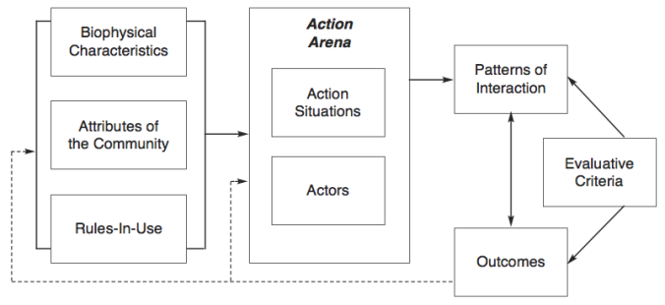
Institutional Analysis & Development (IAD) framework (Ostrom lab)
Critique of game theory (rational, but helpless actors) to instead focus on interacting and learning individuals, in community and over time).
Deal with complexity, instead of rejecting it
Polycentric governance system can cope with complexity

Slide 6
Gist of Ostrom approach
The gist of Ostrom’s research to date underscores a non-rational, non-efficiency based view of polycentric institutional arrangements that provide for durable, resilient, and sustainable governance.
Challenge to models of rational, if ‘trapped’, individuals
By pulling in Ostrom’s work we engage extend these lines of research, highlighting how a theory of the commons can improve our understanding the complex institutional arrangements that can contribute to successful governance within collaborative and conflicting field environments.

Slide 7
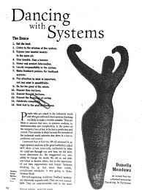

D Meadows, Leverage points 1999
The more I listened, the more I began to simmer inside. “This is a HUGE NEW SYSTEM people are inventing!” I said to myself. “They haven’t the SLIGHTEST IDEA how this complex structure will behave,” myself said…. “It’s almost certainly an example of cranking the system in the wrong direction

Slide 8
Leverage pts 2.0: Places to intervene (increasing order of effectiveness, 12 -> 1)
12. Constants, parameters (subsidies, taxes, standards).
11. Sizes of buffers, other stabilizing stocks, relative to flows.
10. The structure of material stocks and flows (such as transport networks, population age structures).
9. The lengths of delays, relative to the rate of system change.
8. The strength of negative feedback loops, relative to the impacts they are trying to correct against.
7. The gain around driving positive feedback loops.
6. The structure of information flows (who does and does not have access to information).
5. System (such as incentives, punishments, constraints).
4. Power to change, evolve, or self-organize system structure.
3. The goals of the system.
2. The mindset or paradigm out of which the system — its goals, structure, rules, delays, parameters — arises.
1. The power to transcend paradigms.

Slide 9
Varieties of research
Fix the world
Scale a solution
Re-imagine a process
Unbuild incumbent systems
Build different systems
Hack existing systems

Slide 10
Why talk about ‘systems’?
Adapted from Ventresca, 2019
Much lively discussion, focus about ‘systems’ at many levels in many policy sectors. For many: How to change (fix, refocus, redirect) in intentional ways?
However, ‘systems’ has become cultural meme, loosely framed: Reflect experience, focus beyond single organization solutions
How to understand boundaries, interdependencies, systems components, and temporal rhythms?
How to ‘hack’ systems (Savaget 2019) based on analogy from computer hackers, in cases across Africa, Brazil.

Slide 11
Skoll Centre research focus
Foundation grants support projects on 1) Impact investing and 2) Systems Change Observatory (SCO).
The SCO portfolio has 3 work packages:
Narratives of systems change: How frames, models, templates influence how people see problems, solutions, obstacles, challenges. With P Savaget.
Pathways of social impact ventures that focus on systems change. Current project, starting with Skoll venture data. Where do you get to , based on where you start
Lessons from technology innovation: Impact features, caution/skepticism about only tech ‘solutions’

Slide 12
Skoll research questions
How do key global and other funders define systems change? What are available conceptions of system change?
According to whom?
And (why) do these conceptions matter?

Slide 13
Study design, methods
Initial sample of visible, large-scale funders of systems change activities:
  Acumen, Ashoka, Bertha Centre, Echoing Green, Gates, Rockefeller, Schwab and Skoll
  Increase sample to include more variation in funder types
Research design: Code source public text from 2019 to generate early, initial data. Next steps to code from archival sources for 2009 and 2014
Exploratory, open textual coding: 1st order codes:
Level of the organization;
Nature of system;
Emphasis on purposeful, distributed change interventions

Slide 14
Systems change: Initial conceptions from incumbent funders (Savaget & Ventresca)
1. Disrupt the status quo
2. Influence chains of cause-and-effect
3. Empower agents
4. Coordinate agents better
5. Scale up
6. Scale deep
7. Impact beyond organisational level
Notes:
THIS IS THE WALK AWAY

Slide 15
1. Disrupting the status quo
Assumes undesired systemic inertia. Since systems are characterised by self-organization, they work coherently and often resist to radical change.
The essence here is building up momentum to change to another, but more desirable self-organized configuration, in which the system can be self-reproduced without constant intervention of the social entrepreneur.
Notes:
THIS IS THE WALK AWAY

Slide 16
2. Influencing chains of cause-effect
Assumes a mismatch between intended and delivered functions of the system. This mismatch tends to be associated to feedback loops. These are closed chains of causal connections that lead to self-reinforced, vicious cycles, which blur the ability of identifying the root causes of problems.
The focus here is, therefore, on identifying and addressing root causes of self-reinforced problems.
Notes:
THIS IS THE WALK AWAY

Slide 17
3. Empowering agents
Assumes that hierarchies of agents within the system are either intrinsically problematic or preventing problems from being addressed. A few privileged actors prioritise their interests, hence leading to a prevalent system of exclusion, in which social problems are either neglected or inappropriately addressed.
Associated to this conception is thus the ideal of democratizing power dynamics, enabling disenfranchised agents to take action.
Notes:
THIS IS THE WALK AWAY

Slide 18
4. Better coordination
Assumes that weak connections between different agents of the system is what constraints the implementation of successful solutions. They point to missed value deriving from the poor articulation of agents, who are either acting in isolation or creating inefficient parallel structures.
The focus here is neither on changing the ‘players’ nor the ‘rules’ of the game, but to invest instead on better coordination among the existing players towards common goals.
Notes:
THIS IS THE WALK AWAY

Slide 19
5. Scaling up
This conception interprets the ‘system’ as what the organization does not yet reach. The expectations of system performance are therefore shaped by what the social entrepreneur is capable of achieving.
As a result, the focus lies on the organizational capacity of expanding the scale of its operations and/or offerings beyond its original reach.
Notes:
THIS IS THE WALK AWAY

Slide 20
6. Scaling deep
Assumes that the system fails to deliver other products and/or services within the boundary of the organization’s current coverage. Similar to scaling up, it is very shaped by what the social entrepreneur leading the change is capable of achieving.
Differently from scaling up, the focus here lies on the organizational capacity of expanding the scope of its offerings within the original boundary.
Notes:
THIS IS THE WALK AWAY

Slide 21
7. Impacting beyond org-level
Considers that systemic changes are the ones occurring beyond what the organisation leading the change is responsible or accountable for. Resonates with the idea of impacting the organizational ‘ecosystem’.
The focus here is, therefore, on engaging with broader social problems, taking a more proactive approach on issues that impact its ecosystem.
Notes:
THIS IS THE WALK AWAY

Slide 22

Building large-scale tech systems: 19th c Natl electricity grids (excerpted, Ventresca & Zhao 2010)
System builders “…forge unity from diversity, centralize in face of pluralism, [thread] coherence from chaos… often involves destruction of alt [existing] systems.”
System building work:
  Rethink existing value chains
  Assemble resources, capabilities across incumbent boundaries
  Invent new solutions and means
  Broker expertise
  Build capacity and infrastructure to harness [nascent] ecosystem
  Unbuild and co-opt legacy systems

Slide 23
Arc of invention to impact: System building infrastructure I – D – I - T – C
System phase | Primary activities | Key actors | Supporting elements
Invention | Create raw ‘novelty’; external to current common sense | Independent inventors unconstrained by organizations | Academics, vendors, corporate R&D, patent offices
Development | Embed invention in business functions; recognize PESTEL | Inventor-entrepreneur or organization | Other professionals (e.g. engineers, scientists) and institution actors
Innovation | Produce value from emerging tech – value creation system (VCS) | Manager-entrepreneur (e.g., Schumpeter on entrepreneurs) | Incumbent and new entrants, new dominant designs
Tech Transfer | Adapt and adopt technology: Impact on markets & industries | Context-specific actors ‘customize’ innovation in local value regimes | Political and legal environment; industry leaders
Commercializa-tion: Growth and competition | Build system momentum; notice & resolve reverse salients | Finance- and policy- entrepreneurs; incremental innovation | System momentum makes tech appear inevitable trajectory
Source: Adapted from Hughes by Ventresca & Zhao 2011; Seidel 2013.

Slide 24
One view of Edison’s laboratory (Source: Hargadon SFI 2011)

Slide 25
Edison innovated via distributed, long-linked networks (Hargadon, Santa Fe Institute 2010)

Slide 26
System builders at work
What rules of the game?
What interdependences?
How best to create ‘architecture of participation?
Managing difference, plural voices/ multivocality
Experiment, pilot, prototype
Do this, again, and again
When and how to ‘close’ the situation?

Slide 27
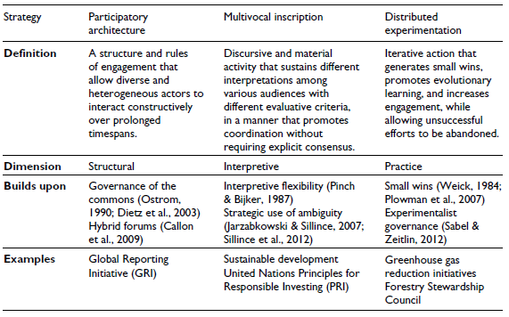
Ecosystem strategies for action:
Engage, many voices, experiment (Ferraro et al 2015)

Slide 28
‘The future is already here,
It is just very unevenly
distributed.’
– W Gibson

